Slide 1

Why GAN, LSTM Autoencoder, and Isolation Forest Are Used in HealthSentinel
AI-Powered Detection of Known Cyberattacks in Hospital Systems

Slide 2

Problem Background: Safeguarding Hospital Systems
Hospital systems generate massive volumes of logs from various sources, making it challenging to identify subtle cyberattack indicators.
Vast Log Generation
Cyberattack Behavioral Patterns
API calls, user activities, IoMT device signals, network events contribute to a deluge of data.
Ransomware, phishing, insider misuse, and privilege abuse exhibit distinct, yet often disguised, behavioral patterns.
Key Challenges
Imbalanced datasets (few attacks, many normal events).
Sequential patterns are complex to model.
Subtle anomalies are easily overlooked.
We require sophisticated models that can comprehensively understand these patterns, behaviors, and anomalies to effectively counter threats.

Slide 3

Why Do We Use GAN? (Generative Adversarial Network)
Reason 1: Addressing Data Imbalance
Reason 2: Generating Realistic Malicious Data
The vast majority of hospital logs represent normal operations. Actual attack logs (e.g., ransomware, insider breaches) are extremely rare, leading to highly imbalanced datasets. Traditional ML models struggle to learn attack behaviors effectively from such skewed data.
GANs excel at creating synthetic, yet highly realistic, attack sequences. This process enriches our dataset with diverse malicious examples, making the training process more robust.
Reason 3: Enhancing Model Training
By balancing the dataset with GAN-generated attack logs, we achieve higher detection accuracy, build a more robust model, and significantly reduce the risk of overfitting to normal data.

Slide 4




How GAN Works in HealthSentinel
1. Generator
2. Discriminator
The generator component takes random noise as input and transforms it into synthetic "fake attack API sequences" that mimic real cyberattacks.
The discriminator learns to distinguish between genuine, real attack patterns and the fake sequences produced by the generator.
3. Training Loop
4. Outcome
Through continuous iteration, the generator improves at creating more realistic attack patterns, while the discriminator simultaneously becomes better at identifying fake ones.
The process yields a rich collection of synthetic attack logs (e.g., phishing, ransomware, privilege misuse), which are then integrated into our training dataset.
This process significantly strengthens our model's capability to detect known cyberattacks by exposing it to a wider variety of malicious scenarios.

Slide 5
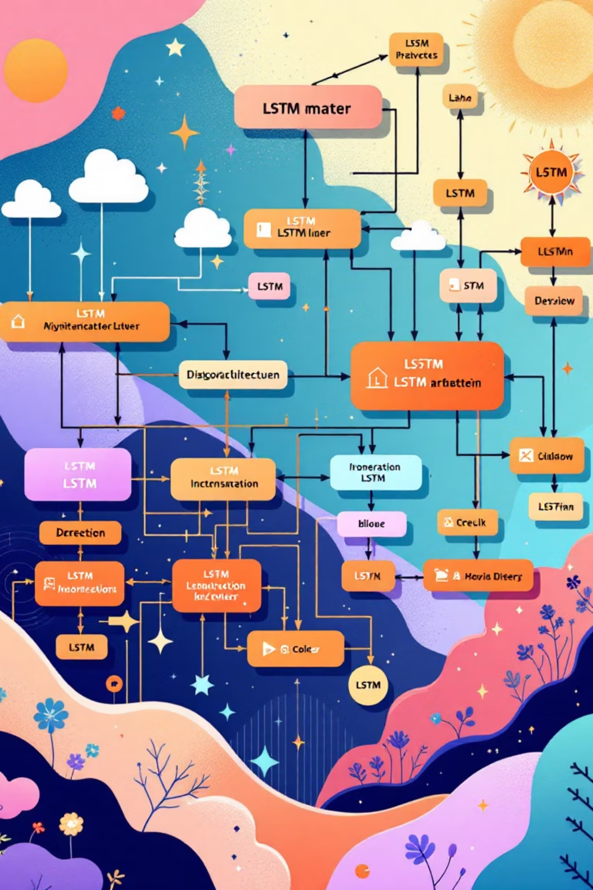



Why Do We Use LSTM Autoencoder?
Reason 1: Understanding Sequence Data
Reason 2: Learning Normal Behavior
Hospital logs are inherently time-based sequences, reflecting API calls, user actions, and network events. LSTMs are uniquely designed to process and comprehend the order, timing, and contextual relationships within these sequences.
The autoencoder component is trained to accurately learn what 'normal' hospital operations and data flows should look like. When it struggles to reconstruct a sequence, indicating a high reconstruction error, it signals potentially abnormal behavior.
Reason 3: Detecting Known Attack Patterns
Known attacks, such as credential abuse or unauthorized file access, invariably manifest as unusual and specific patterns within these sequential logs. The LSTM Autoencoder is adept at identifying these deviations.

Slide 6
How LSTM Autoencoder Works in HealthSentinel
01
02
Step 1: Train on Normal Logs
Step 2: Compress + Reconstruct
The LSTM Autoencoder is initially trained exclusively on sequences representing normal hospital operations, such as "login → view record → update record → logout."
An encoder compresses the learned normal sequence into a latent space representation, and a decoder then attempts to reconstruct the original sequence from this compressed form.
03
04
Step 3: Compare Original vs. Reconstructed
Step 4: Label as Potential Attack
A significant difference between the original input sequence and its reconstructed version (a high "reconstruction error") indicates suspicious or anomalous behavior.
Sequences with high reconstruction error are flagged as potential attacks. Examples include: a sudden database dump, unauthorized administrative access, or irregular activity timings.
This process allows HealthSentinel to effectively detect "behavioral anomalies" directly linked to known types of cyberattacks.

Slide 7

Why Do We Use Isolation Forest?
1
2
Reason 1: Simplicity & Speed
Reason 2: Detecting Point Anomalies
Isolation Forest is highly efficient and scalable, making it perfect for processing the extremely large volumes of hospital logs generated daily without significant computational overhead.
It excels at quickly isolating individual, distinct outliers or "point anomalies" in data. This includes unusual IP addresses, unexpected user behaviors, or suspicious file access attempts.
3
Reason 3: Complementing LSTM
While LSTM focuses on sequential behavior, Isolation Forest effectively catches discrete point anomalies that might otherwise be missed. This synergistic approach provides a more comprehensive detection capability.

Slide 8
How Isolation Forest Works in HealthSentinel
Step 3: Combining with LSTM Output
Step 2: Anomaly Score Calculation
Step 1: Random Splits
We integrate the Isolation Forest anomaly score with the LSTM reconstruction error. This combined metric provides a more nuanced and accurate assessment of threat levels.
Isolation Forest constructs an ensemble of random decision trees. Normal data points require many splits to be isolated, whereas anomalies are isolated much quicker with fewer splits.
The "shorter" the path to isolate a data point within the trees, the stronger its anomaly score. This identifies examples such as failed login bursts, sudden large data transfers, unexpected system scanning, or rare API calls.
This dual approach significantly reduces false positives and ensures more accurate detection of multifaceted cyber threats.

Slide 9
Thank you

